Slide 1
Current standards & going challenges in the care of pts with EGFR mutation metastatic NSCLC
Dr. Nader Abedallaa
Professor in medical oncology ,Faculty of medicine
Head of Medical Oncology Department
Tishreen University Hospital

Slide 2
Plan
Introduction
Frontline Therapy
Combination Therapy With EGFR TKIs
Treatment Options After First-line EGFR TKI
EGFR Exon 20 Insertions, uncommon EGFR mutations
Future Directions
Conclusion

Slide 3
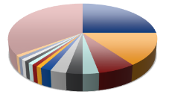
Evolution of Therapy in Lung Cancer
Not one disease, but many
Histologic Breakdown
(eg, SQ, NSQ: large cell, adenocarcinoma)
Molecular Pathology
(eg, EGFR, ALK, ROS1)
SCLC
PD-L1 Expression Level
<1%
Lung Cancer
≥1%-49%
NSCLC
≥50%
Traditional View
Present View
Cooper. Pathology. 2011;43:103. Langer. JCO. 2010;28:5311. Galon. Immunity. 2013;39:11. Pao. Lancet Oncol. 2011;12:175. Krigsfeld. AACR 2017. Abstr CT143.
Notes:
NSCLC, non-small-cell lung cancer; NSQ, nonsquamous; SCLC, small-cell lung cancer; SQ, squamous.

Slide 4
~50% of Patients With Advanced Non squamous NSCLC Have an Actionable Driver Mutation
EGFR Other
4%
(EGFRex20ins
0.1%-4%)
ALK 7%
MET 3%
EGFR Sensitizing 17%
ALK 7%
>1 Mutation 3%
HER2 2%
ROS1 2%
KRAS 25%
(KRAS^{G1C}
13%)
BRAF 2%
RET 2%
NTRK1 1%
PIK3CA 1%
Unknown Oncogenic Driver Detected 31%
MEK1 <1%
Li. JCO. 2013;31:1039. Tsao. JTO. 2016;11:613. Burnett.
PLoS One. 2021;16:e0247620. Nassar. NEJM. 2021;384:185.
Notes:
Adv, advanced; CT, chemotherapy; Nonsq, nonsquamous; NSCLC, non-small-cell lung cancer; PD, progressive disease.
At this point, for patients with adenocarcinoma, the most common type—or we call it “nonsquamous”—but the majority is adenocarcinoma non‑small-cell lung cancer, almost half of them are going to have an actionable driver mutation, at this point, because we’ve identified so many. KRAS makes up a big chunk of that and KRAS G12C is the actionable one there; we’ll talk about that. EGFR makes up a big part (17%), ALK, and then you see a variety of 1%‑2%, like MET, RET, BRAF, ROS1, and HER2, which recently had the first targeted therapy approved.

Slide 5
EGFR Mutations in NSCLC: Overview
Uncommon EGFR mutations in NSCLC
More common (but not exclusively)
Never/minimal smokers, East Asians, Women, adenocarcinoma
Classical mutations make up majority
Exon 19del
Exon 21point/L858R
Atypical/uncommon EGFR mutations
Including G719X, L861Q, S768I
Some are sensitive to traditional EGFR inhibitors
More study needed
Others – 0.9%
Exon 20 ins 12.8%
G719X 6.1%
Exon 19 del 44.2%
L861Q 2.4%
L858R 31.3%
S768I 2.4%
Exon 20 insertions
Resistant to traditional EGFR inhibitors
New drugs approved
Sehgal. Oncologist. 2021;26:281.
Notes:
NSCLC, non-small-cell lung cancer.
We’ll start with talking about EGFR mutations. This was kind of the first thing that we were able to target in non‑small-cell lung cancer. It is more common in never or minimal smokers and East Asian women, but not at all exclusively; we find this in males of all races and ethnicities all the time.
Classical mutations make up the majority. We used to only see EGFR, but now we have to classify them, because we’re finding so many different types of EGFR mutations that respond differently. The classical mutations are an exon 19 deletion or exon 21 point mutation, so they make up about 75% of the mutations.
Then, if you look at some of the atypical or uncommon EGFR mutations, they are typically resistant to some of our EGFR inhibitors. And I’m not going to ask you to remember, but if you see these come across in one of your reports, hopefully the pathologist who read this will say, “These are an uncommon but targetable EGFR mutation.” The only drug that’s approved for these right now is afatinib. There is some data for osimertinib, but the largest amount of data is afatinib, which is a typical EGFR inhibitor, and there is data that that these will respond. Now, they don’t respond nearly as well as the classical mutations, which make up the majority, but many of the other EGFR inhibitors they don’t respond to at all.
And then the other thing that we’re going to talk a little bit about is exon 20 insertions, which make up about 12% of all EGFR mutations, and there are 2 new drugs approved for this. Again, the exon 20 insertions are very resistant to traditional EGFR inhibitors; they usually don’t work.

Slide 6
Frontline Therapy for classical EGFR-Mutated Advanced NSCLC
Notes:
NSCLC, non-small-cell lung cancer.

Slide 7
FLAURA: First-line Osimertinib vs Erlotinib or Gefitinib for EGFR-Mutated Advanced NSCLC
Double-blind, randomized, phase III study
Primary endpoint: investigator-assessed PFS (RECIST v1.1)
Secondary endpoints including ORR, DoR, DCR, depth of response, OS, PRO, safety
Stratified by EGFR mutation (del[19] vs L858R) and race (Asian vs non-Asian)
Until PD or unacceptable toxicity
Crossover to open-label osimertinib allowed upon progression and T790M+
confirmation
Osimertinib 80 mg PO daily
(n = 279)
Treatment-naive patients with advanced NSCLC adenocarcinoma with an EGFR exon 19 or 21 mutation, WHO PS 0/1, stable CNS metastases permitted
(N = 556)
EGFR TKI SoC
Erlotinib 150 mg or Gefitinib 250 mg
PO daily
(n = 277)
Soria. NEJM. 2018;378:113. Ramalingam. NEJM. 2020;282:41.
Notes:
CNS, central nervous system; DCR, disease control rate; DoR, duration of response; NSCLC, non-small-cell lung cancer; ORR, overall response rate; OS, overall survival; PD, progressive disease; PFS, progression-free survival; PRO, patient-reported outcomes; PS, performance status; RECIST, Response Evaluation Criteria in Solid Tumors; SoC, standard of care; TKI, tyrosine kinase inhibitor.

Slide 8
FLAURA: Survival
 | Median PFS, Mo (95% CI)
Osimertinib (n = 279) | 18.9 (15.2-21.4)
Erlotinib/gefitinib (n = 277) | 10.2 (9.6-11.1)
 | Median OS, Mo (95% CI)
Osimertinib (n = 279) | 38.6 (34.5-41.8)
Erlotinib/gefitinib (n = 277) | 31.8 (26.6-36.0)
PFS
Updated OS
1.0
1.0
0.8
0.8
0.6
0.6
Probability of PFS
Probability of OS
0.4
0.4
0.2
HR: 0.46
(95% CI: 0.37-0.57; P <.001)
0.2
HR: 0.80
(95.05% CI: 0.64-1.00; P = 0.046)
0
0
0
3
6
9
12
15
18
21
24
27
0
3
6
9
12
15
18
21
24
27
30
33
36
39
42
45
48
51
54
Mo
Mo
PFS, Mo (95% CI) | Osimertinib | Erlotinib/Gefitinib | HR
EGFR ex19del | 21.4 (16.5-24.3) | 11.0 (9.7-12.6) | 0.43
EGFR L858R | 14.4 (11.1-18.9) | 9.5 (8.1-11.0) | 0.51
Soria. NEJM. 2018;378:113. Ramalingam. NEJM. 2020;282:41.
Notes:
OS, overall survival; PFS, progression-free survival.

Slide 9
FLAURA: PFS by EGFR Mutation
EGFR ex19del
EGFR ex21.L858R
Median PFS,
Mo (95% CI) 21.4 (16.5-24.3)
11.0 (9.7-12.6)
Median PFS,
Mo (95% CI) 14.4 (11.1-18.9)
9.5 (8.1-11.0)
Osimertinib (n = 175)
Erlotinib or gefitinib (n = 174)
Osimertinib (n = 104)
Erlotinib or gefitinib (n = 103)
1.0
1.0
0.8
0.8
0.6
0.6
Probability of PFS
Probability of PFS
0.4
0.4
0.2
HR: 0.43
(95% CI: 0.32-0.56; P <.001)
0.2
HR: 0.51
(95% CI: 0.36-0.71; P <.001)
0
0
0
3
6
9
12
15
18
21
24
27
0
3
6
9
12
15
18
21
24
27
Mo
Mo
Patient at Risk, n
Osimertinib | 175 | 167 | 151 | 139 | 122 | 96 | 46 | 18 | 4 | 0
First-gen EGFR TKI | 174 | 157 | 132 | 105 | 74 | 55 | 25 | 9 | 2 | 0
Patients at Risk, n
Osimertinib | 104 | 95 | 82 | 71 | 56 | 43 | 25 | 8 | 0 | 0
First-gen EGFR TKI | 103 | 82 | 65 | 47 | 33 | 23 | 12 | 1 | 0 | 0
Soria. NEJM. 2018;378:113.
Notes:
Gen, generation; PFS, progression-free survival; TKI, tyrosine kinase inhibitor.

Slide 10
FLAURA: PFS by CNS Metastases at Baseline
With CNS Metastases at BL (n = 116)
Without CNS Metastases at BL (n = 440)
 | Median PFS, Mo (95% CI)
Osimertinib (n = 53) | 15.2 (12.1-21.4)
1st-Generation EGFR TKI (n = 63) | 9.6 (7.0-12.4)
 | Median PFS, Mo (95% CI)
Osimertinib (n = 226) | 19.1 (15.2-23.5)
1st-Generation EGFR TKI (n = 214) | 10.9 (9.6-12.3)
1.0
1.0
0.8
0.8
0.6
0.6
Probability of PFS
Probability of PFS
0.4
0.4
0.2
HR: 0.47
(95% CI: 0.30-0.74; P <.001)
0.2
HR: 0.46
(95% CI: 0.36-0.59; P <.001)
0
0
0
3
6
9
12
15
18
21
24
27
0
3
6
9
12
15
18
21
24
27
Patients at Risk, n
Osimertinib
1st-Generation EGFR TKI
Mo
Patients at Risk, n
Osimertinib
1st-Generation EGFR TKI
Mo
53
63
51
57
40
40
37
33
32
24
22
13
9
6
4
2
1
1
0 0
226
214
211
182
193
157
173
119
146
83
117
65
62
31
22
8
3
1
0 0
CNS progression occurred in 17 patients (6%) with osimertinib vs 42 (15%) with 1st-generation EGFR TKI
Soria. NEJM. 2018;378:113.
Notes:
BL, baseline; CNS, central nervous system; PFS, progression-free survival; SoC, standard of care; TKI, tyrosine kinase inhibitor.

Slide 11
Combination Therapy With EGFR TKIs
Notes:
TKI, tyrosine kinase inhibitor.

Slide 12
Rationale for Combination Therapy With an EGFR TKI + a VEGFR Inhibitor in EGFR+ Advanced NSCLC
Preclinical data have demonstrated costimulation of EGFR and VEGF signaling pathways in EGFR+ NSCLC
Upregulated EGFR leads to upregulation of VEGF
VEGF signaling promotes angiogenesis to support oncogenesis, contributes to EGFR TKI resistance
VEGF(R)-targeted agents approved for treatment of advanced NCLC, with inhibition of VEGF signaling appearing to sensitize tumor cells to other anticancer therapies
Crosstalk Between and Inhibition of VEGF and EGFR Signaling
Bevacizumab
VEGF-A
VEGF-C
1st-Generation TKI: Erlotinib, Gefitinib
2nd-Generation TKI: Afatinib, Dacomitinib
3rd-Generation TKI: Osimertinib
Antibody:
Amivantamab
Necitumumab
VEGF-D
EGF
EGFR
VEGFR-2
Ramucirumab
Vandetanib
Ras
Raf
Mek
Erk
PI3K
AKT
M-TORC1
Nintedanib Axitinib Cediranib
HIF-1α
HIF-1α
VEGF production
Le. J Thoracic Oncol. 2020;16:205..
Notes:
NSCLC, non-small-cell lung cancer; TKI, tyrosine kinase inhibitor.

Slide 13
Phase III NEJ009: Gefitinib ± Carboplatin/Pemetrexed in EGFR-Mutated Advanced NSCLC
Stratified by sex, stage, EGFR mutation, and smoking history
Induction Phase
Maintenance Phase
Gefitinib QD +
Carboplatin/Pemetrexed
Q21D, 4-6 cycles
(n = 170)
Gefitinib QD +
Pemetrexed Q21D
(n = 170)
Treatment continued
until PD
Treatment-naive patients with stage IIIB/IV or recurrent nonsquamous NSCLC, EGFR mutation–positive, ECOG PS 0/1
(N = 342)
Gefitinib QD
(n = 172)
Treatment continued until PD followed by platinum-based regimen as recommended by protocol
Primary endpoints: PFS1, PFS2, OS
Secondary endpoints: ORR, QoL, safety
Nakamura A, et al. ASCO 2018. Abstract 9005.

Slide 14
Treatment Options After First-line EGFR TKI
Notes:
TKI, tyrosine kinase inhibitor.

Slide 15
Resistance More Challenging With Newer EGFR TKIs
Acquired Resistance Mechanisms With Early-Gen EGFR TKIs¹
Candidate Acquired Resistance Mechanisms With Osimertinib*³
Unknown 18%
HER2 8%
EGFR
EGFR
HER2 + T790M 4%
HER2
HER2
HER2
HER2
MET
MET
MET
MET
MET amplification 3%
Secondary EGFR mutations†: C797X: 7%; L718Q+C797S: 1%; L718Q + ex20ins: 1%; S768I: 1%
HER2 amplification: 2%
HER2 mutation: 1%
SPTBN1
ALK
Small cell + MET 1%
SPTBN1-ALK: 1%
MET amplification: 15%
Small cell 1%
Small cell + T790M 2%
PIK3CA
PIK3CA mutations: 7%
BRAF mutations (V600E): 3%
RAF
T790M 60%
MET + T790M
3%
KRAS mutations (G12D/C, A146T): 3%
RAS
mTOR
AKT
p53
Cell cycle gene alterations
CCND amp: 3%
CCNE1 amp: 2%
CDK4/6 amp: 5%
MEK
BIM
BCL2
G2
ERK
T790M is the dominant mechanism of resistance to 1st- and 2nd-gen EGFR TKIs‡
S
M
Apoptosis
Survival
G1
Proliferation
*Overlap of reported resistance mechanism may occur. †n = 2 with de novo T790M mutations at BL; 1 acquired C797S at progression.
‡In the phase III RELAY trial, the post-progression T790M rate was 43% and 47% with ramucirumab + erlotinib vs placebo + erlotinib, respectively.²
No dominant and more heterogeneous mechanisms of resistance to 3rd-gen EGFR TKI osimertinib
1. Yu. Clin Cancer Res. 2013;19:2240. 2. Nakagawa. ASCO 2019. Abstr 9000. 3. Ramalingam. ESMO 2018. Abstr LBA50.
Notes:
gen, generation; TKI, tyrosine kinase inhibitor.

Slide 16
Reasonable Strategy for Oligoprogression: Consolidative Local Therapy at MRD and Continuing Same EGFR TKI
Randomized phase II study comparing LCT vs MT/O in stage IV NSCLC with ≤3 metastases and no PD at ≥3 mo after frontline systemic therapy (N = 49)
Patients with oligoprogression and MRD after ≥3 mo of systemic therapy benefited from consolidative local therapy vs maintenance or observation
Study closed early by DSMB due to PFS and OS benefit with local therapy
Local therapy followed by continued EGFR TKI delays time to new systemic treatment and extends PFS and OS
PFS
1.00
Patients, n
mPFS, Mo
25
14.2
0.75
LCT
MT/O
PFS Probability
24
4.4
0.50
P = .022
0.25
0
0
12
24
36
48
Mo
Patients, n
mOS, Mo
OS
25
41.2
LCT
MT/O
1.00
24
17.0
P = .017
0.75
OS Probability
0.50
0.25
0
0
12
24
36
48
60
Mo
Gomez. JCO. 2019;37:1558.
Notes:
DSMB, data and safety monitoring board; LCT, local consolidative therapy; m, median; MRD, measurable residual disease; MT/O, maintenance or observation; NSCLC, non-small-cell lung cancer; OS, overall survival; PD, progressive disease; PFS, progression-free survival; TKI, tyrosine kinase inhibitor.

Slide 17
Treatment Options for Acquired Resistance on First-line Osimertinib
On Target
Off Target
None Identified
Lineage Plasticity
Second EGFR mutation: 1st or 2nd generation EGFR TKI
EGFR exon 20 in seration
MET amp: crizotinib, tepotinib, capmatinib, savolitinib
RET fusion: selpercatinib, pralsetinib
ALK fusion: alectinib
BRAF mutation: trametinib ± dabrafenib
HER2 mutation/amp: T-DM1, T-DXd
Clinical trial
Chemotherapy
SCLC or squamous transformation: chemotherapy
Notes:
SCLC, small-cell lung cancer; T-DM1, trastuzumab emtansine; T-DXd, trastuzumab deruxtecan.

Slide 18
Treatment Options for Patients With EGFR Exon 20 Insertions, uncommon EGFR mutations

Slide 19
EGFR Exon 20 Insertions Account for 12% of EGFR Mutations
Frequency and Distribution of EGFR Mutations in NSCLC (N = 2251)
Ex20ins: n = 261, 12%
L858R: n = 721, 32%
S768I: n = 15, 1%
L861Q: n = 52, 2%
ex19del+L861Q: n = 2 L861Q+S768I: n = 1
G719X: n = 96, 4%
Compound mutations:
n = 50, 2%
G719X+S768I: n = 29
ex19del+ex20ins: n = 1 G719X+L681Q: n = 10
ex20ins+L858R: n = 6 G719X+L858R: n = 1
Ex19del: n = 1056, 47%
Riess. J Thorac Oncol. 2018;13:1560.
Notes:
NSCLC, non-small-cell lung cancer.

Slide 20
Mobocertinib in EGFR Ex20ins+ Advanced NSCLC: Efficacy
Mobocertinib (TAK-788): orally active, first-in-class, irreversible EGFR TKI that targets EGFRex20ins mutations¹
DoR
1.0
Median DoR (confirmed):
17.5 mo (95% CI: 7.4-20.3)
Mobocertinib | Amivantamab
FDA approval | Accelerated approval September 15, 2021
Indication | Advanced/metastatic EGFR exon 20 insertion mutation–positive NSCLC + PD on platinum chemo
Dose, route | 160 mg QD ± food
Available dosage | 40-mg capsule
Common AEs, all grades (≥20%): | Diarrhea, stomatitis, vomiting, decreased appetite, nausea, decreased weight, rash, paronychia, dry skin, pruritis, fatigue, cough
Common laboratory abnormalities (≥25%): | Decreased RBC, lymphocytes, platelets, leukocytes, potassium Increased creatinine, amylase, lipase, alk phos
Warnings/Precautions: | ILD/pneumonitis, cardiac toxicity, diarrhea, EFT
Significant DDIs: | Strong, moderate CYP3A inhibitors, inducers
0.8
0.6
Probability of Maintaining Response
0.4
0.2
0
0
2
4
6
8
10
12
14
16
18
20
22
24
Patients
at Risk, n
Mo
32
29
23
19
17
10
6
5
5
2
2
1
0
1.0
OS
Median OS:
24.0 mo (95% CI: 14.6-28.8)
0.8
0.6
Probability of OS
0.4
0.2
0
0
4
8
12
16
20
24
28
32
36
Patients
at Risk, n
Mo
114
103
85
61
21
15
13
8
2
0
Data cutoff: November 1, 2020.
1. Riely. Cancer Discov. 2021;11:1688. 2. Zhou. JAMA Oncol. 2021;7:e214761. 3. Mobocertinib PI. 2021.
Notes:
ICR, blinded independent central review; CT, chemotherapy; DoR, duration of response; NSCLC, non-small-cell lung cancer; PFS, progression-free survival; plt, platinum; RR, response rate; std, standard; tx, treatment.
The other drug that was just approved in September this past year, is called mobocertinib. Mobocertinib, again for exon 20 insertions, so the smaller piece of the pie. The difference is, this is a capsule, so if patients don’t want to do an IV, it’s a capsule that you can take. You take it once a day with or without food. They’re 40-mg capsules, so you take 4 all at once.
A lot of diarrhea with this drug. Again we saw long durations of response: 17.5‑month duration of response. A median overall survival of 24 months where the other one was 22 months. These are very similar across trials, but patients do really respond well, generally, and that is a prolonged response.

Slide 21
CHRYSALIS Phase I Trial: Amivantamab in NSCLC w/EGFR Exon 20 Insertion and PD on Plt-Doublet CT
Outcomes in efficacy population (n= 81) †
ORR 40% (95% CI, 29-51)
Median DoR 11.1 months (95% CI, 6.9-NR)
Median PFS 8.3 months (95% CI 6.5-10.9)
Median OS 22.8 months (95% CI, 14.6-NR)
Amivantamab | Amivantamab
FDA approval | Accelerated approval May 21, 2021
Indication | Advanced/metastatic EGFR exon 20 insertion mutation–positive NSCLC + PD on platinum chemo
Dose, route | Weight <80 kg: 1050 mg Weight ≥80 kg: 1400 mg Administer wkly* x 4, then Q2W beginning Wk 5
Available dosage | 350-mg/7-mL single-dose vial
Common AEs, all grades (≥20%): | Rash, IRR, fatigue, edema, paronychia, musculoskeletal pain, dyspnea, cough, nausea, stomatitis, constipation, vomiting
Common laboratory abnormalities (≥25%): | Decreased albumin, phosphate, magnesium, sodium, potassium, lymphocytes Increased glucose, alk phos, creatinine, ALT, AST, GGT
Warnings/Precautions: | IRR, ILD/pneumonitis, dermatologic AEs, ocular toxicity, EFT
Significant DDIs: | None listed
† Data cutoff: June 8, 2020.
*Initial dose split on Week 1 Day 1 and Day 2
Park. JCO. 2021;39:3391. Amivantamab PI. 2021.
Notes:
CBR, clinical benefit rate; CR, complete response; CT, chemotherapy; DoR, duration of response; ECOG PS, Eastern Cooperative Oncology Group performance status; NE, not evaluable; NR, not reached; ORR, overall response rate; OS, overall survival; PD, progressive disease; PFS, progression-free survival; Plt, platinum; PR, partial response; SD, stable disease; tx, treatment.
Now switching gears a little bit to the EGFR exon 20 insertions, remember, this is the one that makes up about 12% of all EGFR mutations, so it’s a much less common EGFR mutation but something that we do see. And there are 2 drugs that have now been approved recently in this setting. This one was approved in May of last year: it’s called amivantamab. Both of these drugs are approved after failure of chemotherapy, so they’re not first line, they’re in the second‑line setting, but patients had a 40% response rate. The median duration of that response was 11 months—almost a year—so that’s really actually very exciting. The median overall survival was almost 2 years at 22.8 months. This is in the second‑line setting after progression on chemotherapy, so that’s really good, actually.
This IV monoclonal antibody has a little bit of an odd dosing schedule; you have to do weekly for the first 4 weeks and then every other week after that. It has a really high rate of infusion‑related reaction, but it almost always happens on the very first dose, which is why we split the first dose over 2 days. And it’s not like a paclitaxel reaction where people become hypotensive; usually, it’s something that we can manage and rechallenge them pretty easily. But like I said, it is an IV, so that’s a little different than what we’re used to with the orals.

Slide 22
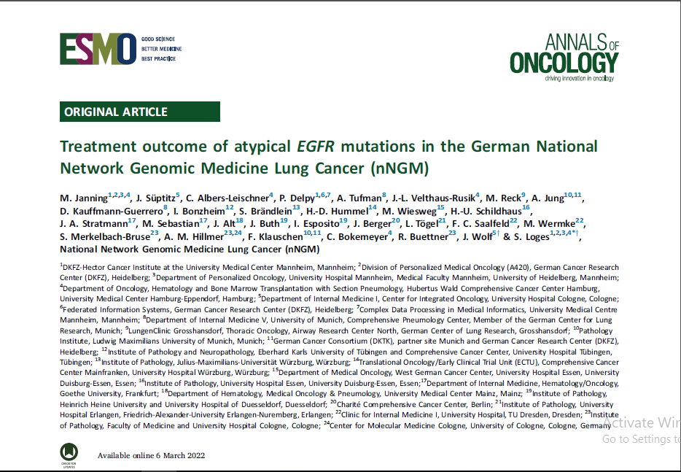
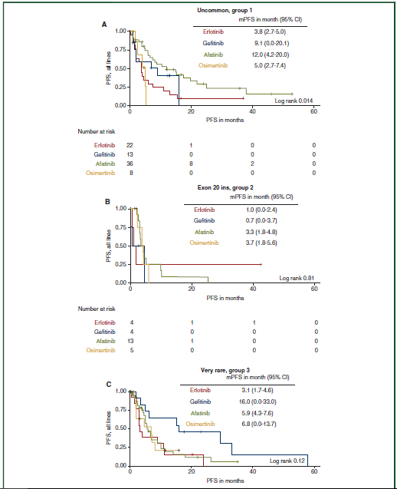
Afatinib Approved in Advanced NSCLC Harboring Uncommon EGFR Mutations

Slide 23
Future Directions for Advanced NSCLC With Common EGFR Mutations
Notes:
NSCLC, non-small-cell lung cancer.

Slide 24
Conclusion
Notes:
NSCLC, non-small-cell lung cancer.

Slide 25
2022 Treatment Paradigm for Molecular Biomarker–Positive Advanced NSCLC
Advanced NSCLC (Molecular Biomarker Positive)
EGFR
ALK
ROS1
BRAF V600E
NTRK
RET
METex14
skipping
KRAS G12C
HER2
Classical (del19 or L858R)
Uncommon
Alectinib, brigatinib, or lorlatinib (preferred);
ceritinib or crizotinib‡
Crizotinib
or
entrectinib
Dabrafenib/
trametinib†
Entrectinib
or
larotrectinib
Selpercatinib
or
Pralsetinib
Capmatinib
or
tepotinib
First line
ex20ins
S768L, L861Q, G719X
Osimertinib (preferred),* erlotinib, afatinib, gefitinib, or dacomitinib†
Afatinib or
osimertinib†
Progression
Amivantamab
or
mobocertinib
Alectinib, brigatinib, ceritinib, or lorlatinib dependent on previous therapy
Sotorasib
Trastuzumab deruxtecan
Second line+
Follow treatment options for adenocarcinoma or squamous cell carcinoma without actionable biomarker (ie, chemotherapy ± immunotherapy)
*Osimertinib also approved as second-line therapy for EGFR T790M–positive disease after an earlier-generation EGFR TKI. †Afatinib, dacomitinib, erlotinib (alone or in combination with ramucirumab), gefitinib, and osimertinib approved for EGFR exon19del, exon 21 L858R; afatinib for EGFR G719X, S768I, L861Q. Osimertinib also a preferred option for EGFR G719X, S768I, L861Q per NCCN guidelines. ‡Or as second-line after CT.
Afatinib PI. Alectinib PI. Amivantamab PI. Capmatinib PI. Ceritinib PI. Crizotinib PI. Dabrafenib PI. Dacomitinib PI. Entrectinib PI. Erlotinib PI. Gefitinib PI. Lorlatinib PI. Larotrectinib PI. Mobocertinib PI. Osimertinib PI. Pralsetinib PI. Selpercatinib PI. Sotorasib PI. Trametinib PI. Trastuzumab deruxtecan PI. NCCN. Clinical practice guidelines in oncology: NSCLC. v.3.2022.
Notes:
Ab, antibody; mDoR, median duration of response; MoA, mechanism of action; mOS, median overall survival; mPFS, median progression-free survival; NSCLC, non-small-cell lung cancer; ORR, objective/overall response rate; TKI, tyrosine kinase inhibitor.

Slide 26
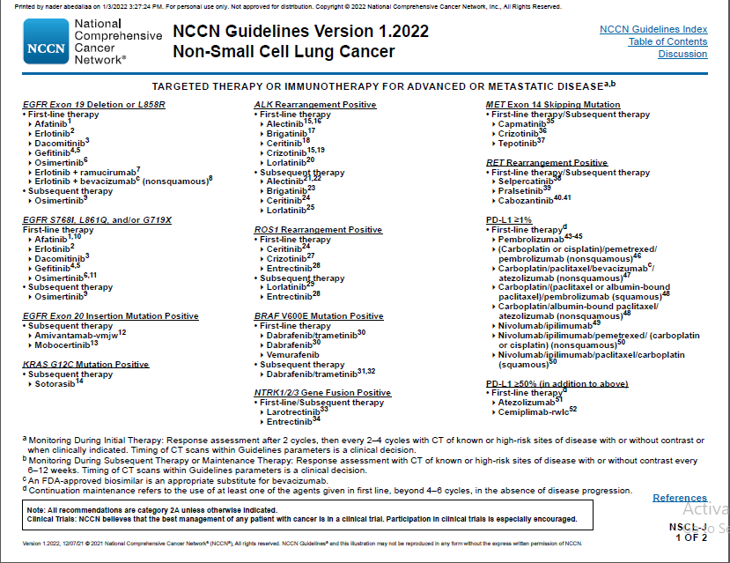

Slide 27
Thank you

